Slide 1
Learning Fair
March 12, 2025

Slide 2


Choices:
Will I work individually?
Will I work with a partner?

Slide 3

A Decision to Make!
Select from the options of Science, History, or Math as your focus for the Learning Fair!

Slide 4
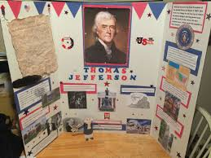
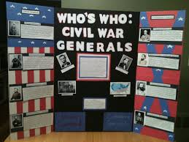
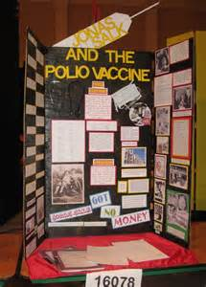
History

Slide 5
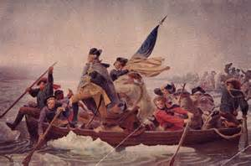
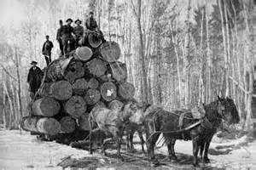
History Ideas
Who were some of the first explorers and missionaries to come to Wisconsin?
What impact has the fur industry had on Wisconsin over time?
What parts of today’s culture have their roots with Native American Indians?
How have Wisconsin products impacted the country and world?
Why did your family or your ancestors decide to come to Wisconsin? What did they find attractive?
Why did the American Revolution occur and how did it impact the entire world?
Who were the great leaders of the Revolutionary war?
What are some of the untold stories of the Revolutionary war?

Slide 6

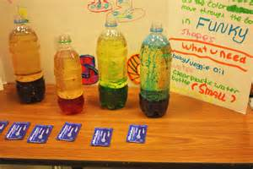
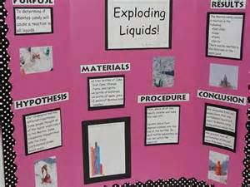
Science

Slide 7

Ideas
How do fingerprints differ?
How fast do you turn a bicycle wheel to generate enough electricity to light a small lamp?
How do 3-D glasses work?
Which foods contain starch?
How can you invent a safe and original toy?
Does the size of a light bulb affect its energy use?
How does the wheel diameter of a skateboard affect its speed?

Slide 8
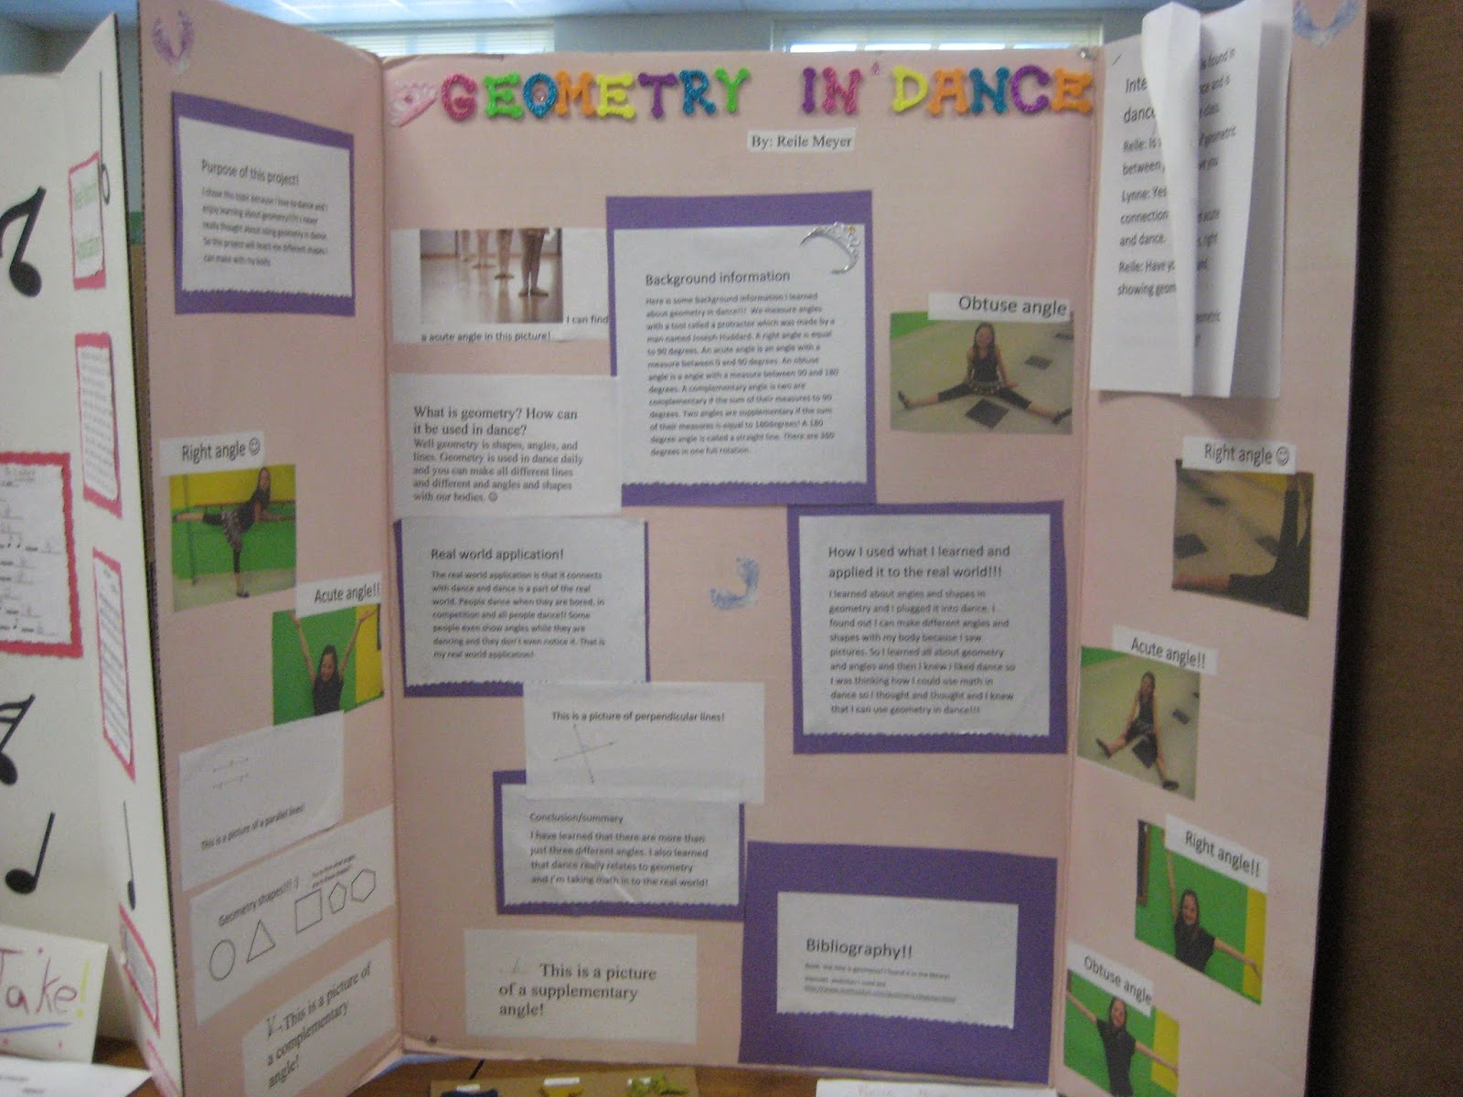

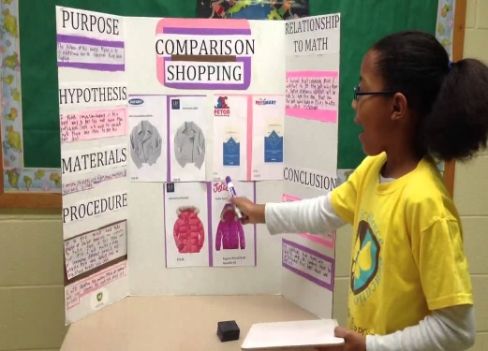
Math

Slide 9
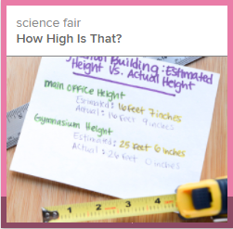
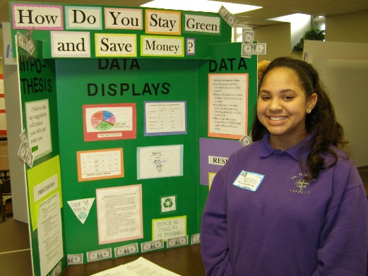
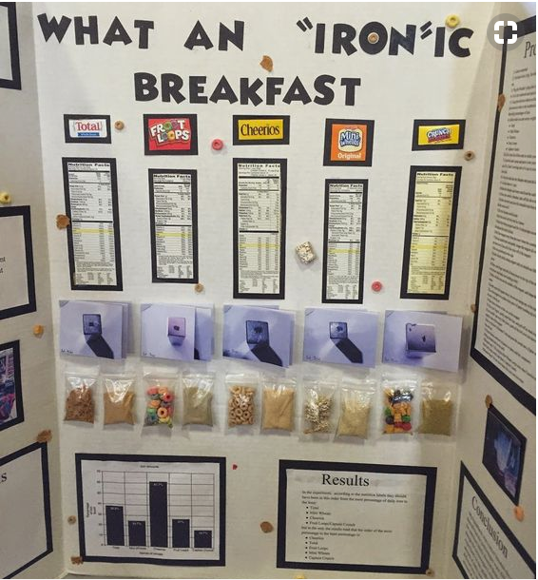
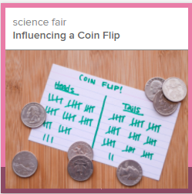
Math Ideas
Math Ideas
Fractals: beauty and chaos in mathematics
What is the optimum packaging?
How do we optimize school bus traffic?
What is the surface area of the school building?
All about circles or pyramids or parabolas

Slide 10
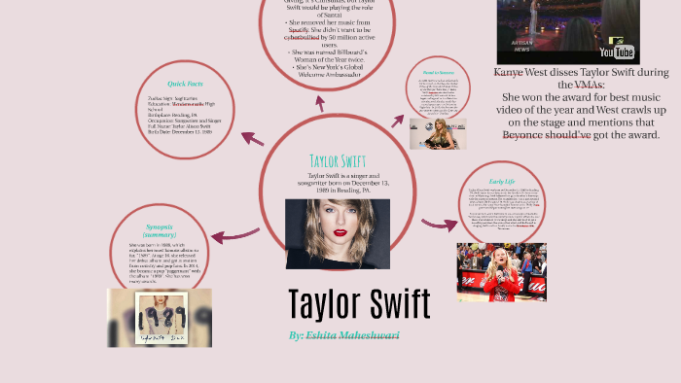
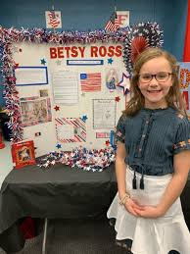
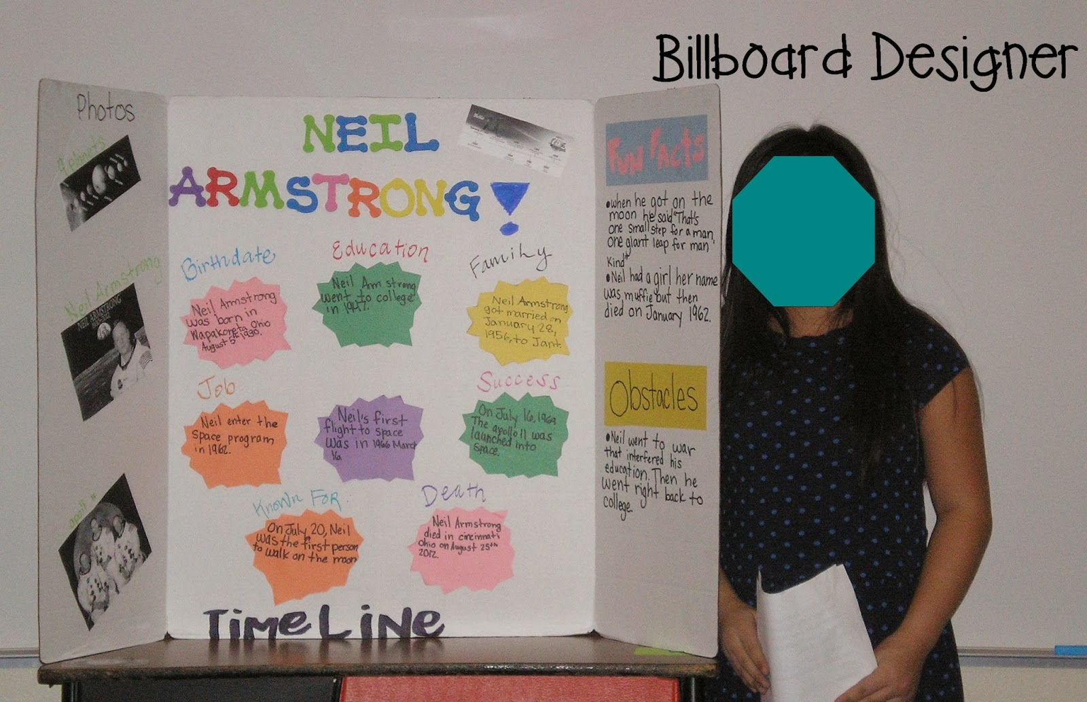
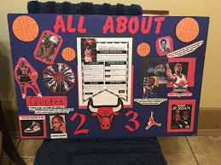
Biography
Consider famous people who changed the world - scientists, athletes, explorers, presidents, authors, musicians, or historical figures!

Slide 11
Online References:
RI website under Learning Fair tab.
Planning information
Project deadlines
Final project display information
Checklists
Project Ideas

Slide 12
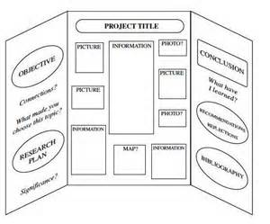
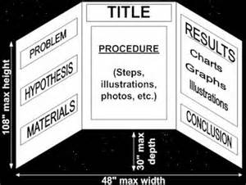
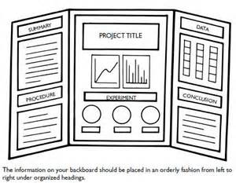
Learning Fair Presentation Board
Boards can be bought from an office supply store in the area.

Slide 13
Turn in permission forms by
Friday, January 24th.
Parent signatures are required on all Learning Fair Plans.

